Slide 1


Topdown appoach
What is Topdown appoach and how to apply it ?

Slide 2
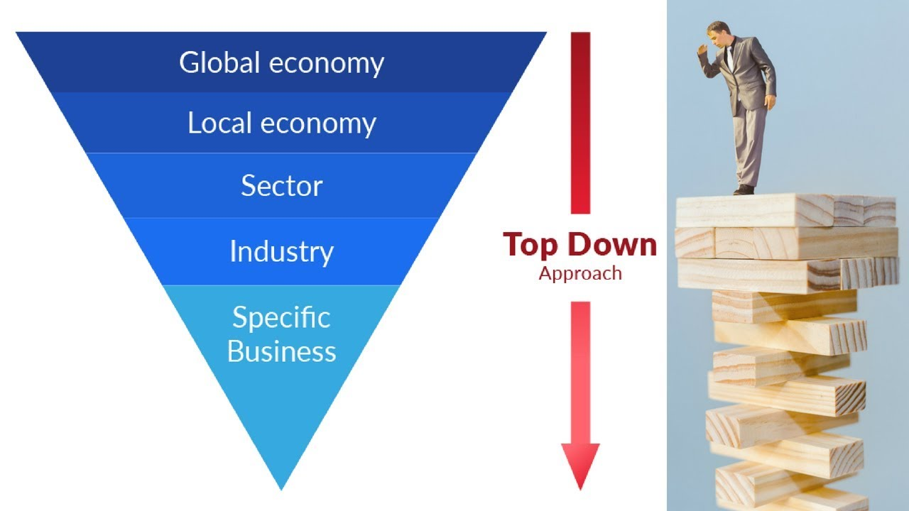
Understanding Top-Down Approach
The Top-Down Approach is a method of organizing information and work processes by starting from the general and gradually delving into the details. It reflects the philosophy of 'starting from the overall goal and gradually breaking down into specific parts

Slide 3
Advantages of the top-down approach
Disadvantages of the top-down approach
Clear Overview: Starting with an overall view helps to understand the overall structure of the system or problem.
Effective Project Management: For project management, the top-down approach helps identify key tasks and allocate responsibilities efficiently.
Risk Management: This approach aids in early identification and management of risks during development.
Focus on Objectives: It keeps the focus on the main objectives of the project and helps avoid distractions.
Time and Resource Savings: Defining the main structure early can reduce inefficient use of time and resources.
Lack of Detail: Starting from the top may overlook some important details.
Difficulty in Handling Changes: Adjusting the structure can be challenging if there are sudden changes in requirements.
Team Understanding Challenges: Team members may face difficulties in understanding and implementing the top-down model without effective communication.
Control Challenges at Detail Level: It may be challenging to control and manage details at a high level.
Risk of Object Loss: There is a risk of missing out on leveraging dynamic ideas and input from the lower levels of the organization.

Slide 4


Applying Top-Down Approach in “Journey to your best” program

Slide 5


Begin by defining a focused learning goal
Break Down into Major Sections
Clearly outline what you aim to achieve or understand by the end of your study.
Divide the overarching topic into its major sections or key components.
For instance, if learning a programming language, categorize it into syntax, data types, and common terminology.

Slide 6
Preliminary Understanding
Organize Material Hierarchy
Gain a preliminary understanding of each major section.
This involves obtaining a general overview or context before delving into specific details.
Organize the material in a hierarchical structure, starting from the broadest concepts down to more granular details.
This helps in creating a mental roadmap for your learning journey.

Slide 7


Application Example
When you join this program and you receive a request:“Optimizing Web Application Performance”.

Slide 8

Step 1: Identify - Goal
Identify the core problem related to web application performance and set the goal for optimization.

Slide 9

Step 2: Break Down
Break down the problem into factors such as page load speed, user interactions, and database optimization.

Slide 10
Step 3: Address Each Part
Focus on systematically addressing each problem, starting with the most impactful factor.

Slide 11
Step 4: Synthesize and Review
Synthesize improvements and assess the overall performance of the entire web application.

Slide 12

Conclusion
The application of the "Top-Down Approach" not only enhances information management and problem-solving skills but also establishes an organized and effective approach across different aspects of life. Try it out and explore further the flexibility and power of this method! Thank you for joining the presentation!

